Slide 1
From A 👉 to Gen Z
A Conversation With Sean Hill, Senior Content Writer, and Jacqui Weishaar, Senior Communications Specialist

Slide 2
Here’s the Game Plan for This Webinar
Start by talking about Gen Z and who they are to make sure we’re all on the same page.
Discuss what will make Gen Z want to go to college.
Go through Capture’s list of ways we are communicating effectively with Gen Z.
Let’s talk about what all of you are doing and open the floor to questions!

Slide 3
Ch-ch-ch-chaaaaaanges!
The aim of a generational study … is not to succumb to nostalgia for the way things used to be; it’s to understand how they are now.”
—Jean M. Twenge

Slide 4
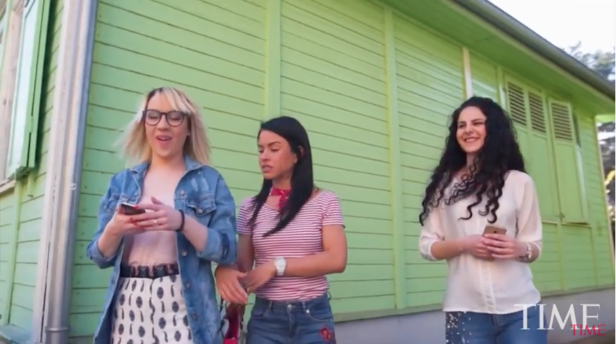
But Really, Who is Gen Z?
… Let’s Take a Poll!
Now Let's Watch This Video: How Generation Z Will Change The World

Slide 5
What’s It Like to Be a Gen-Z’er?
Some Crazy Notes from The Beloit College Mindset List for the Class of 2021:
They are the last class to be born in the 1900s.
Justin Timberlake has always been a solo act.
They are the first generation for whom a phone has been primarily a video game, direction finder, electronic telegraph and research library.
In college, they will often think of themselves as consumers, who’ve borrowed a lot of money to be there.
It is doubtful that they have ever used or heard the high-pitched whine of a dial-up modem.
Men have always shared a romantic smooch on television.
As toddlers, they may have taught their grandparents how to Skype.

Slide 6
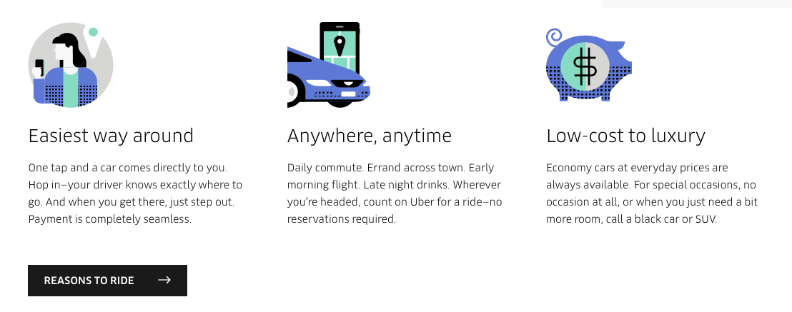

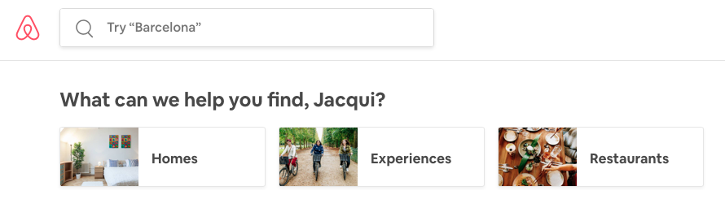
What Are Uber, Airbnb and Teen Vogue Doing Right for Gen Z?

Slide 7
What will Make Gen Z Want to Go to College?
Some Notes from Ryan Jenkins, who Spoke at Capture’s Resolve Conference:
65% of the youth entering school today will work jobs that do not currently exist.
67% of Gen Z says their top concern is affordability.
75% of Gen Z says there are other ways of securing an education than traditional college.

Slide 8
Capture’s Insights on Communicating Effectively with Gen Z
Be authentic.
Use student voices to tell your story.
Communicate visually.
Encourage the student to get connected through social media.
Focus on affordability.
Meet the student where they are.
Get to the point quickly.
Try new things!

Slide 9
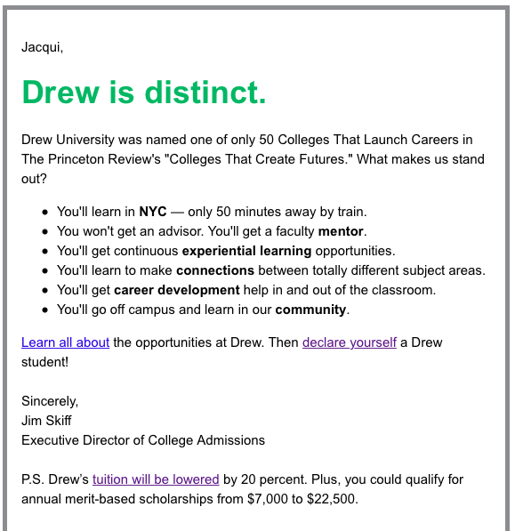
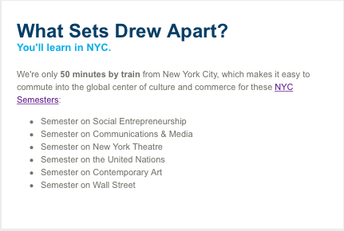
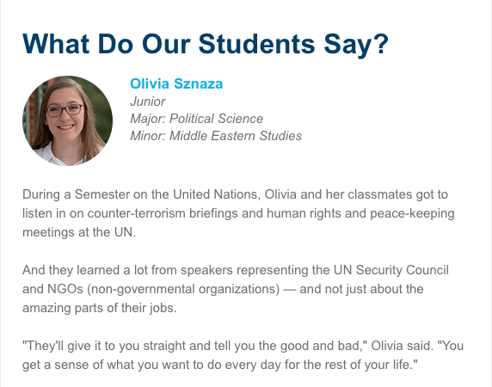
Be Authentic. (Don’t Be “Cookie Cutter.”)

Slide 10
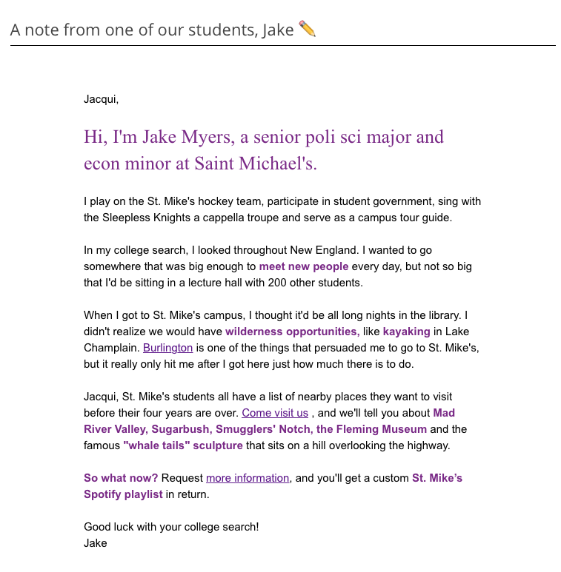
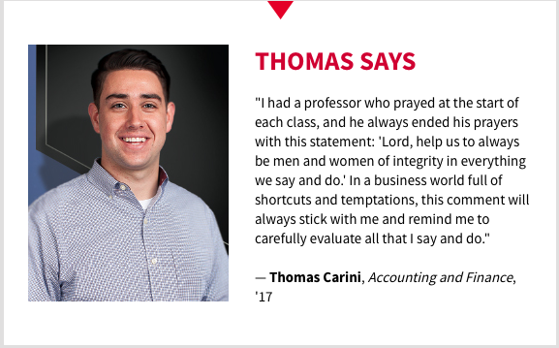

Use Student Voices to Tell Your Story (Slide 1)

Slide 11
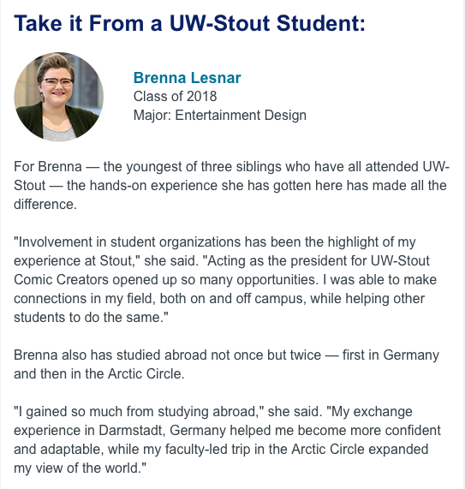
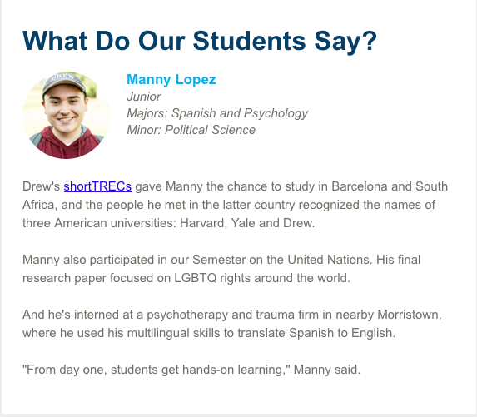
Use Student Voices to Tell Your Story (Slide 2)

Slide 12
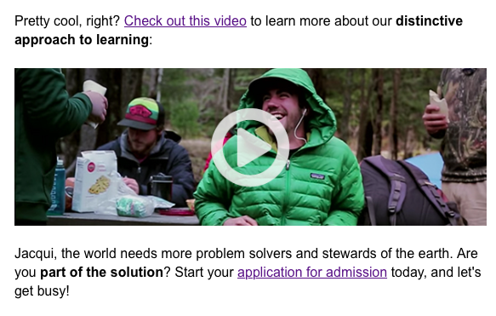

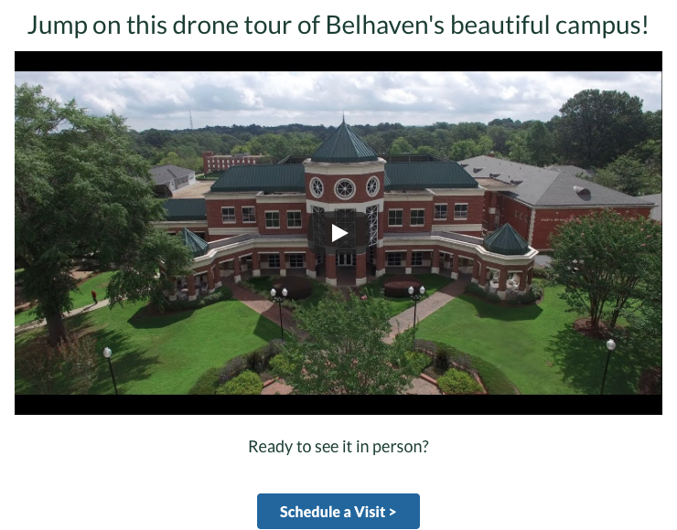
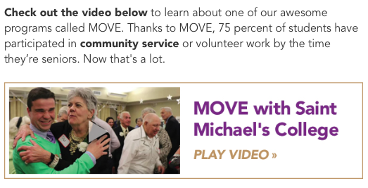
Communicate Visually — Through Videos

Slide 13
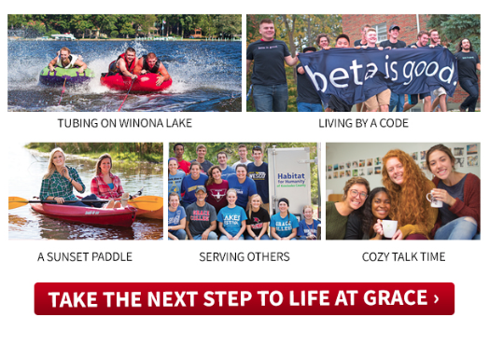
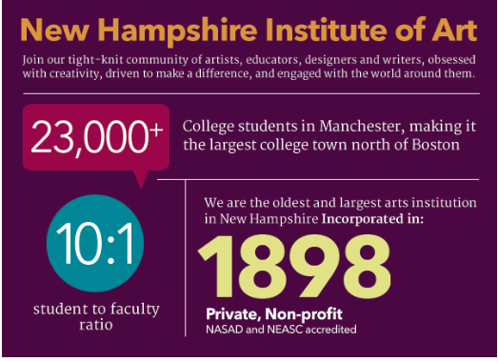
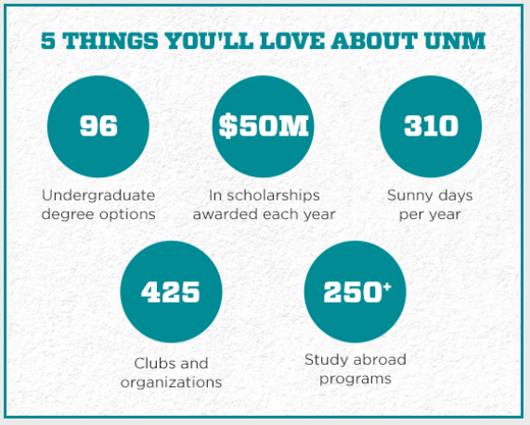
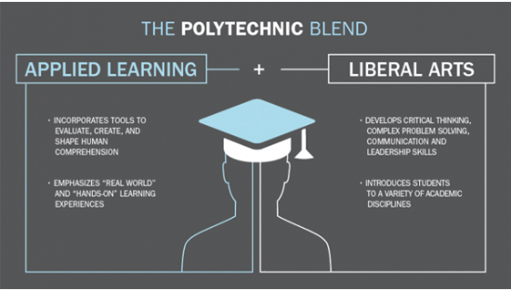
Communicate Visually — Through Engaging Graphics

Slide 14

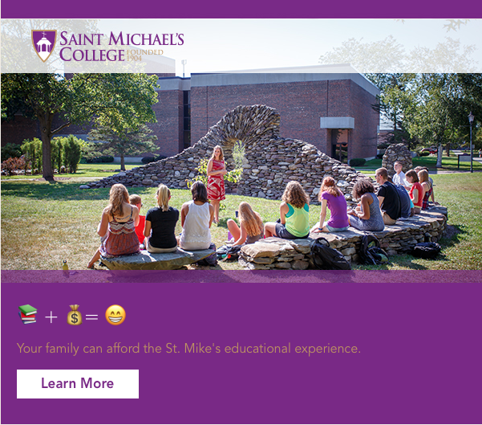

😍😍😍 Communicate Visually — Through Emojis 😍😍😍

Slide 15




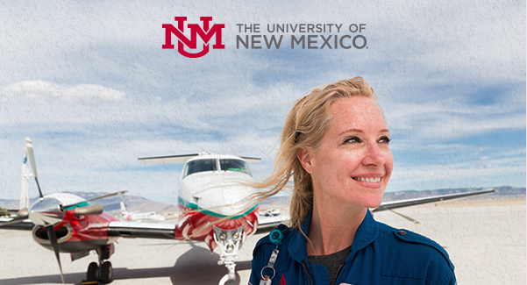
Communicate Visually — Through Eye-Catching Images of Students

Slide 16


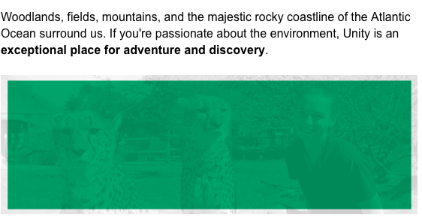
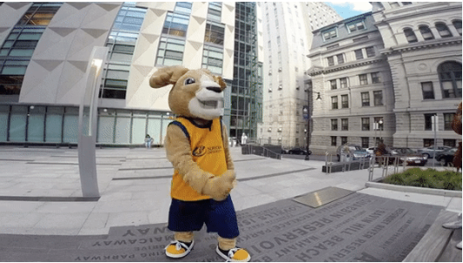
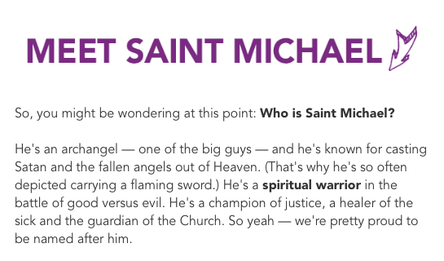
Communicate Visually — Through GIFs

Slide 17
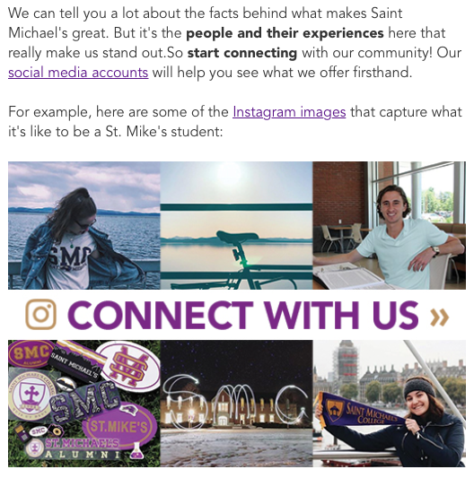
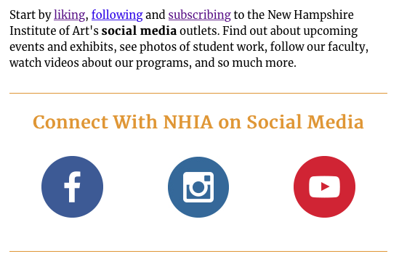

Encourage the Student to Get Connected Through Social Media

Slide 18
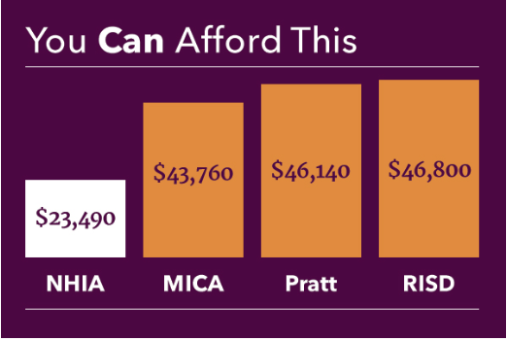

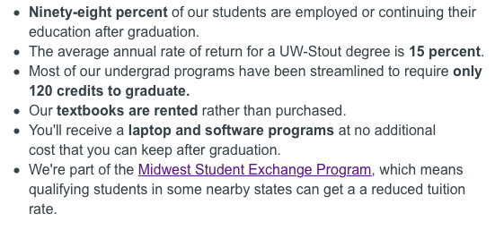

Focus on Affordability

Slide 19
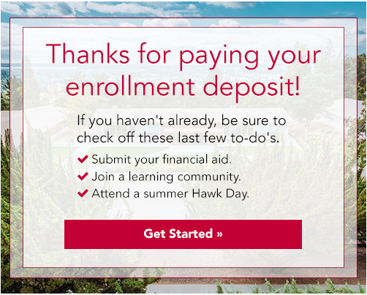


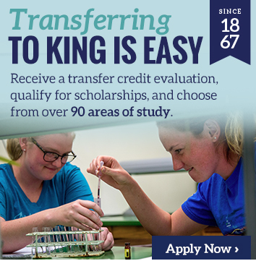


Meet the Student Where They Are

Slide 20

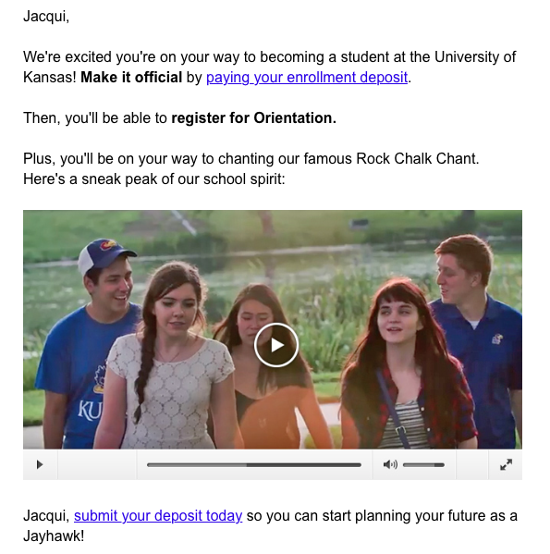
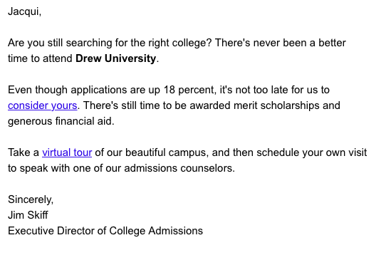
Get to the Point Quickly

Slide 21

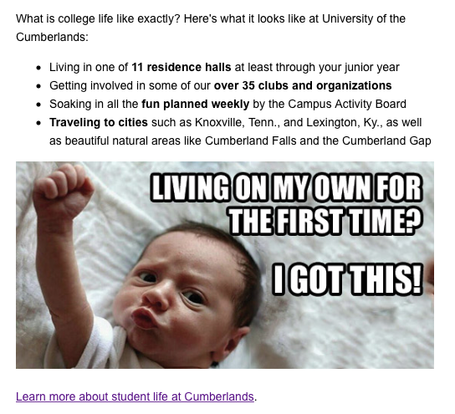
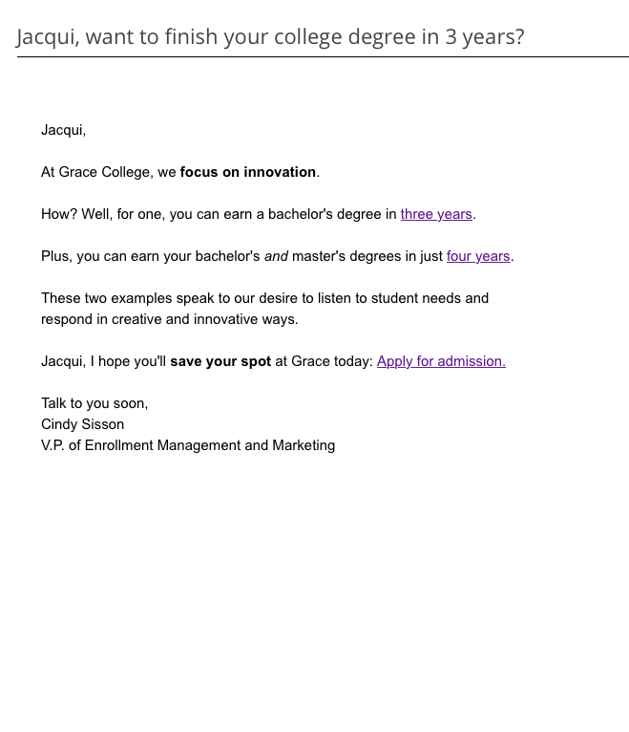

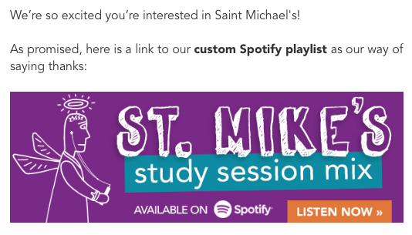
Try New Things!

Slide 22
What are you doing to communicate with gen z?

