Slide 1


December 10, 2025
Transforming Lives. Restoring Sight.

Slide 2
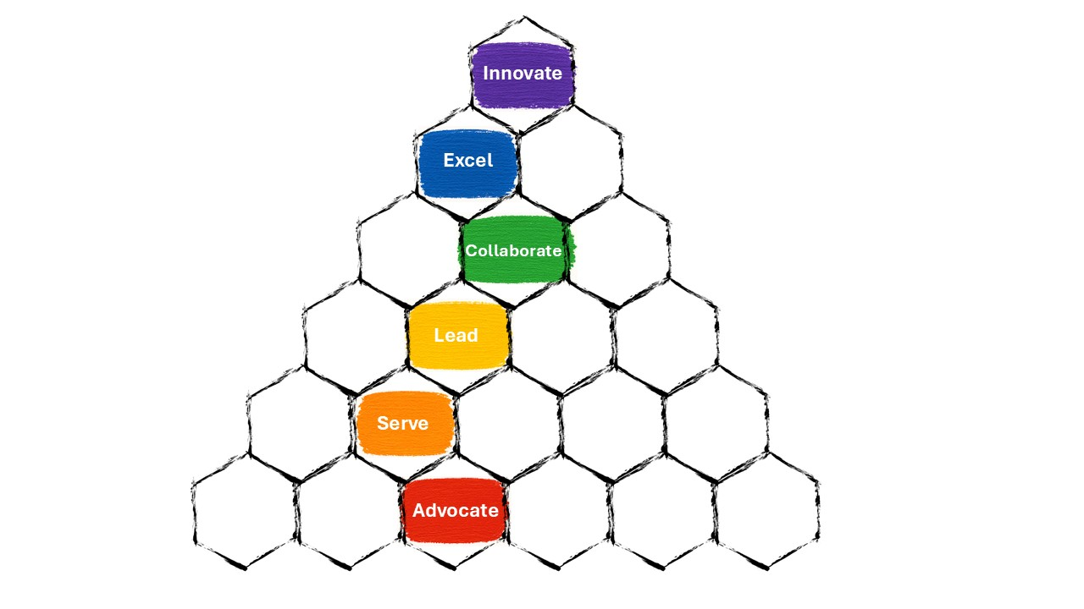
SIX PILLARS
Innovate with Impact: Drive meaningful innovation that makes a difference.
Excel in Quality: Commit to excellence in every aspect of the business.
Collaborate Strategically: Work together across teams and disciplines for optimal results.
Lead with Solutions: Tackle challenges proactively and provide clear direction.
Serve with Intention: Deliver purposeful, high-impact service.
Advocate with Empathy: Put people first, listen actively, support employees and customers.
UNCOMPROMISING INTEGRITY

Slide 3
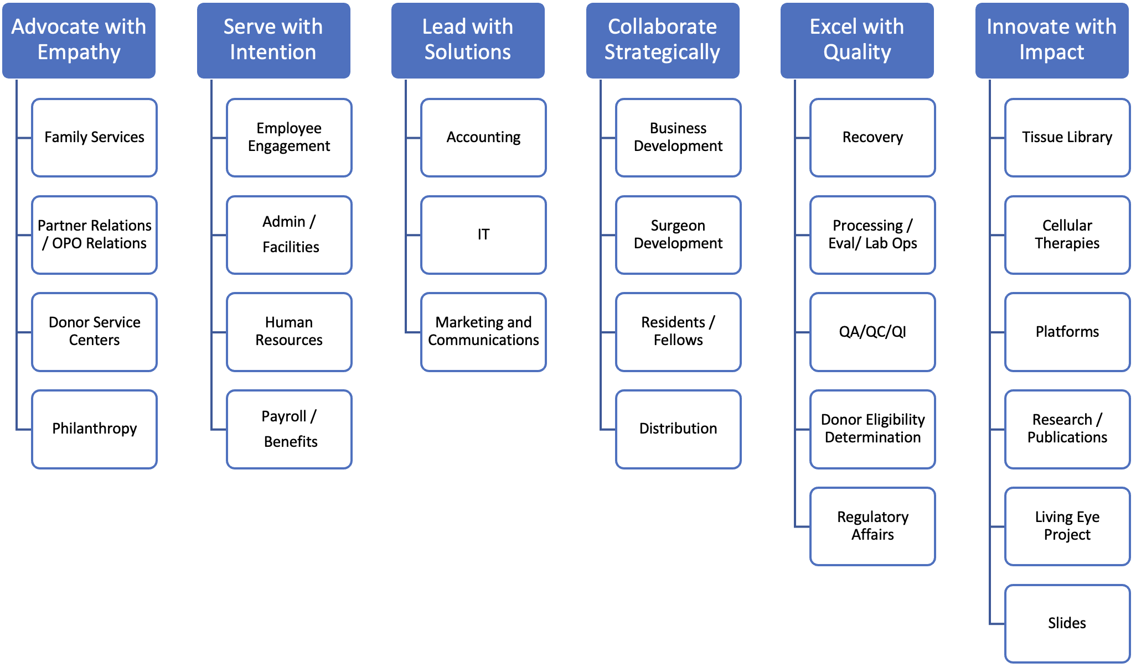

Slide 4

What have we been working on?

Slide 5
Open Enrollment
Dec. 1, 2025
Transfer Payroll from
Paylocity to Paycom
Establish Company
Name & Logo
Scheduling
Contract
Assignments
Combining
Employee
Handbooks
Finalizing
Merger
Agreement
Closing MIS 403B
Options for 401K
Finalizing
Org Chart
Determine Final
Board Composition
Completing
New Organization
Bylaws
Composing
2026 Budget
Consulting to Create
Fund Development
Program

Slide 6
Unified Leadership for a Stronger Organization
Alan Blake and Ingrid Schunder will serve as Co-CEOs, combining complementary strengths to guide our new organization into the future.
This model ensures broad coverage of organizational needs and a unified vision.

Slide 7
Why Co-CEOs?
1. Complementary Skill Sets: Each Co-CEO brings unique strengths, recognize and utilize the skills each leader brings to the table.
2. Clear Responsibilities: Defined roles prevent overlap and confusion, supporting efficient decision-making.
3. Shared Accountability: Both Co-CEOs are equally responsible for organizational outcomes, fostering collaboration and mutual support.
4. Operational Clarity: Mechanisms for conflict resolution and unity are in place to ensure smooth operations.
5. Simple Communication: The structure is explained clearly to staff and the board to gain understanding and support.

Slide 8
Core Principles for Success
Clearly defined, complementary roles prevent overlap by dividing responsibilities based on strengths. For example, one may handle internal operations and the other might manage external relations, thus reducing confusion and conflict.
Shared Vision and Accountability
Both leaders must be fully aligned on the nonprofit's mission, vision, and long-term strategic goals. They are jointly accountable to the board of directors and stakeholders for the organization's overall performance and impact.

Slide 9
Strong Communication Protocols
Co-CEOs need a high tolerance for discussion and a commitment to robust, transparent communication. Regular, dedicated check-ins and shared information systems ensure both leaders are fully informed and are confident presenting a united front to board, staff and external partners.
Transparent Decision-Making by Co-CEOs
The Co-CEOs operate according to clearly established protocols that specify responsibility for various decisions. For significant issues, they adhere to a predefined process to ensure decisions are finalized efficiently.

Slide 10
Equal Power Dynamics:
Ensuring that both leaders maintain equal credibility and influence is essential to prevent the perception that one holds predominant authority. The balance in relationships and visibility within and outside the organization plays a critical role in shaping how their leadership is perceived.
Trust and Mutual Respect:
A strong, respectful, and trusting relationship between the co-leaders is fundamental. This requires humility and a willingness to support a co-leader's decision even if it wasn't one's first choice, once a decision has been made.

Slide 11



Slide 12
1. Unified Leadership for a Stronger Organization
Alan Blake and Ingrid Schunder will serve as Co-CEOs, combining complementary strengths to guide our organization into the future.
This model ensures broad coverage of organizational needs and a unified vision.
2. Clear Division of Responsibilities
Ingrid Schunder oversees advocate, lead, and collaborate service areas.
Alan Blake oversees serve, excel, and innovate service areas.
Defined roles prevent overlap, confusion, and bottlenecks, supporting efficient decision-making.
3. Commitment to Transparent Communication
Regular staff-wide emails, frequent meetings, and updates on the staff portal will keep everyone in our organization informed.
Staff will not receive contradictory communications from both leaders—information will be centralized for clarity.

Slide 13
4. Centralized Contact Point
Kym Mitchell is the primary contact for staff questions, partner inquiries, and portal communications, ensuring consistency and streamlined information flow.
5. Continuing Traditional Eye Banking
Traditional Eye Banking remains a core service and priority.
All Staff and partners can expect ongoing support for established practices and standards.
6. Expanding into Innovation and Development
New focus areas include cellular research, biobanking, and advanced therapeutics.
Our organization is committed to being a leader in both traditional and emerging ocular services.

Slide 14
7. Opportunities for Growth and Development
Staff will have clear communication about roles, responsibilities, and organizational changes.
There will be opportunities for professional growth and development within a unified leadership team.
8. Shared Vision and Accountability
Both Co-CEOs are fully aligned on the organization’s mission, vision, and long-term goals
Alan and Ingrid share collective accountability for successes and challenges, supported by the board.
9. Strong Communication and Trust
Open, constructive dialogue and mutual support are foundational to the Co-CEO model.
Staff can expect transparency, inclusion, and continuous improvement.

Slide 15
10. Strong Communication and Trust
Alan and Ingrid prioritize open, constructive dialogue and mutual support to strengthen their collaboration.
With Co-CEOs, you can expect transparency, inclusiveness, and dedication to continuous improvement in their commitment to the organization.
This trust and communication will extend throughout the organization at all levels to create and maintain a positive and productive leadership team and work environment.
The Co-CEO model empowers our organization, uplifts our team, and drives us to the forefront of both established and cutting-edge ocular care, reflecting our shared commitment to success and visionary leadership.

Slide 16
SIX PILLARS
Innovate with Impact: Drive meaningful innovation that makes a difference.
Excel in Quality: Commit to excellence in every aspect of the business.
Collaborate Strategically: Work together across teams and disciplines for optimal results.
Lead with Solutions: Tackle challenges proactively and provide clear direction.
Serve with Intention: Deliver purposeful, high-impact service.
Advocate with Empathy: Put people first, listen actively, support employees and customers.
UNCOMPROMISING INTEGRITY

Slide 18
Organizational Merger Timeline
Date | Milestone
December 10, 2025 | All-Staff Meeting
December 2025 | Finalize Organizational Chart
December 2025 | 401(k) Options Finalized
December 2025 | Budget Finalized
December 2025 | Merger Agreement Finalized
January 1, 2026 | “Go-Live” Date
January 2026 | Quiet Public Announcement
January 2026 | Microsite Launch
March 2026 | Full Website Launch
June 2026 | High-Visibility Public Announcement (Name, Logo, and Website)

Slide 19

Staff Positions &
Notification
Leadership to notify staff of positions by December 19th
You will receive an email outlining the role and pay by December 23rd
Notification will be signed and returned to HR by December 31st

Slide 20

PUBLIC ANNOUNCEMENT PLANS
Two-Stage Announcement
January 2026 — “Quiet” Public Announcement
Announce the new organization name and logo.
Allows time to complete the website and begin operating as a unified organization.
June 2026 — High-Visibility Public Announcement
Announce the name, logo, website, and full brand expression.
Position the announcement to attract potential partners and broaden reach.

Slide 21
Goals of the Public Announcement
Strengthen understanding among existing audiences
Reinforce the merger news and the beginning of a unified organization.
Emphasize continuity of mission: restoring sight, honoring donation, advancing innovation.

Slide 22
Tell
Tell the new brand’s story effectively
Inspire and engage
Inspire and engage audiences with the brand’s identity, expression, and long-term vision.
Move
Move people from “I heard about the merger” to “I understand who this organization is and why it matters.”

Slide 23
Leverage
Leverage momentum to reach new audiences
Build on
Build on current engagement to expand brand awareness.
Use
Use the announcement moment to warm up new prospects:
clinical partners, business partners, research partners, funders, and industry influencers.

