Slide 1
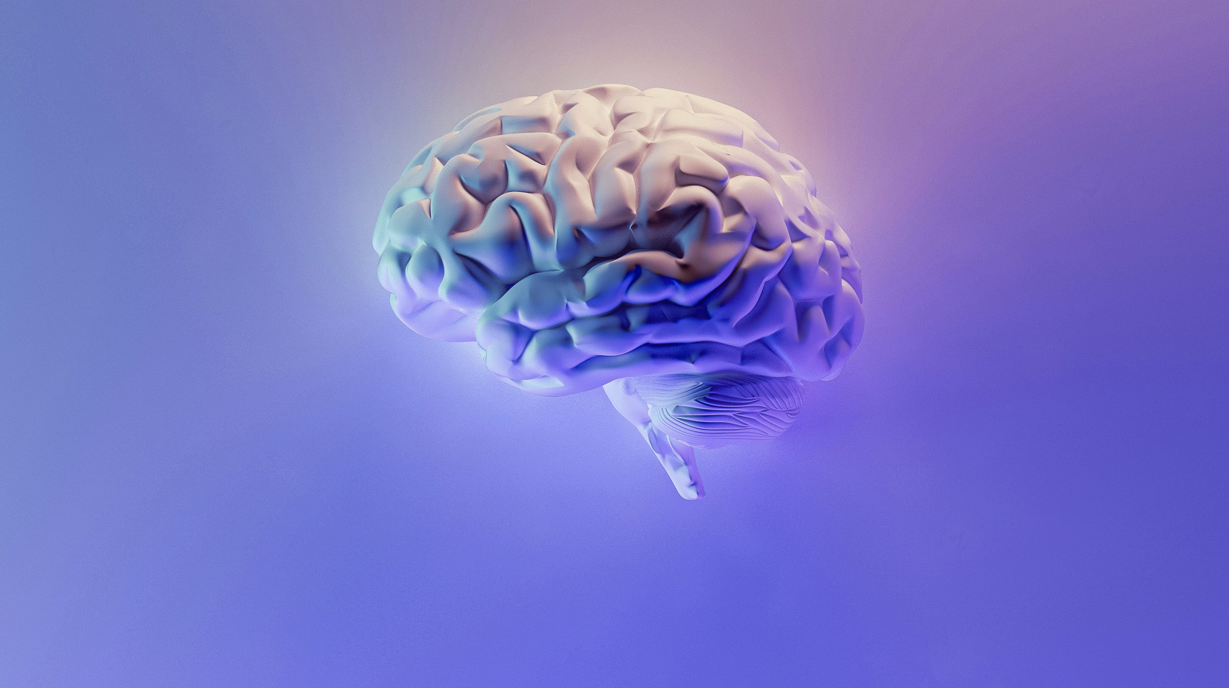
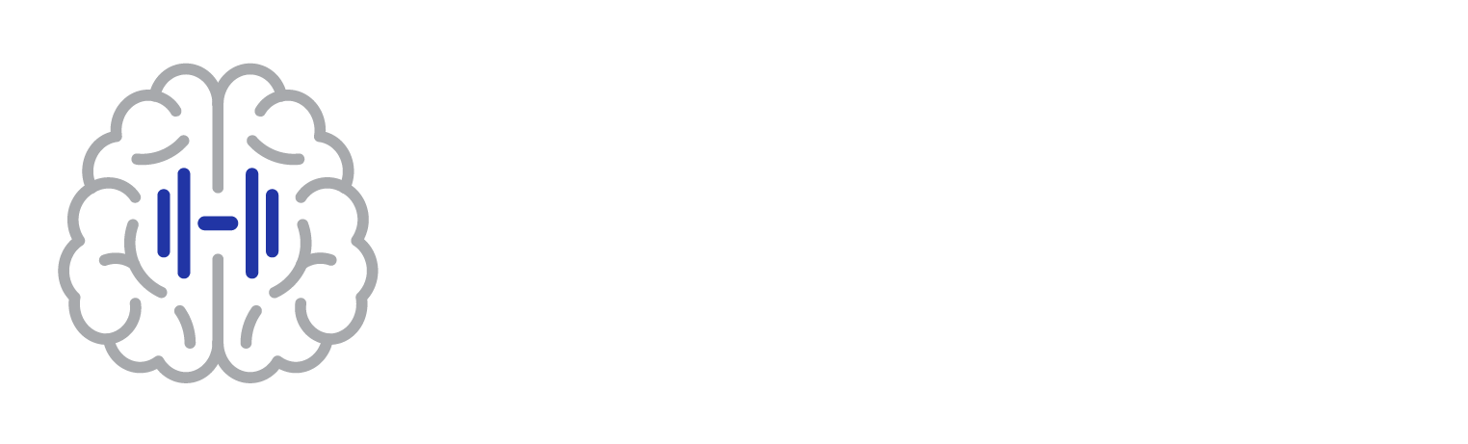
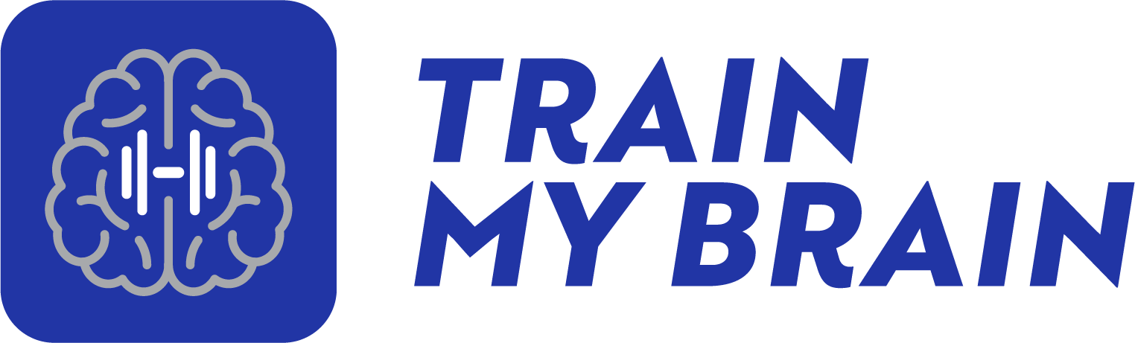
RECOVER FROM BRAIN INJURIES,
TREAT LEARNING DISABILITIES,
COMBAT THE EFFECTS OF AGING.
REAL Brain Training, NOT Brain Games
Bradley A. Schuyler, Ph.D.
C.E.O. of TrainMyBrain

Slide 2

Bradley A. Schuyler, Ph.D., Founder and CEO
Dr. Schuyler is a neuropsychologist who has been practicing for over 40 years. He created one of the first post-acute brain injury rehabilitation programs in the country in 1983 where he began his work with cognitive skills training. This led to the development of the current beta program, Brain Power, which he has been using in his practice for several years with great success. Dr. Schuyler has extensive experience working with patients with brain injuries and learning disorders. Through his work he has identified the critical features which must be incorporated in a cognitive skills training program for it to be maximally effective in promoting brain development. He is dedicated to removing the barriers that prevent access to this form of treatment.
Confidential and not for distribution. Copyright TrainMyBrain. All rights reserved.

Slide 3
THE PROBLEM: Brain Injuries
Traumatic Brain Injuries
2.8 million people sustain a traumatic brain injury EVERY YEAR in America.
2.5 million, nearly 90%, are treated and released from the emergency department. They would be classified as having a mild traumatic brain injury (concussion)
500,000 will have persistent cognitive problems EVERY YEAR.
Stroke
795,000 people have a stroke EVERY YEAR in America.
34% (270,300) are younger than 65 years of age.
Confidential and not for distribution. Copyright TrainMyBrain. All rights reserved.

Slide 4
THE PROBLEM: Learning Disorders
Out of 49.5 million school age children in the United States
Over 34 million (69%) are below basic in reading
Over 38 million (78%) are below basic in math
7.5 million children receive special education services (15% of public-school students).
Over 27 million children DO NOT QUALIFY for services. TrainMyBrain can help all of them.
Students with learning disabilities drop out of high school at nearly three times the rate of all students.
Only 46% of working-age adults with learning disabilities are employed compared with adults who do not have learning disabilities.
Un-addressed learning and attention issues contribute to the
school-to-prison pipeline.
Confidential and not for distribution. Copyright TrainMyBrain. All rights reserved.

Slide 5
Barriers to Treatment
Learning Disorders
Brain Injuries
Special education services are often very limited (e.g. 30 minutes of tutoring twice a week in a small group).
Few families can afford private tutoring.
Regardless, tutoring does not treat the cognitive problems that cause learning problems.
Insurance covers limited outpatient treatment.
Often no more than 10-12 treatment sessions are covered when 3-6 months of daily treatment is actually needed.
Effective treatments are expensive. Inexpensive treatments are not effective.
TrainMyBrain is the only treatment that is both effective and inexpensive.
Confidential and not for distribution. Copyright TrainMyBrain. All rights reserved.

Slide 6
The TrainMyBrain SOLUTION
The solution is called Cognitive Skills Training (CST) and was first developed to treat brain injuries.
CST involves engaging in activities designed specifically to promote brain development and strengthen one or more cognitive skills, the mental processes our brains use to think and learn.
TrainMyBrain has been developed to be effective in treating both brain injuries and learning disorders.
No other program offers all the features of TrainMyBrain.
Confidential and not for distribution. Copyright TrainMyBrain. All rights reserved.

Slide 7

TrainMyBrain
INNOVATION: Removal of Barriers
TrainMyBrain eliminates the need for professional involvement and insurance reimbursement through the use of:
  An online cognitive assessment used to develop of an individualized treatment plan.
  Active AI analysis of subject performance and modification of established task passing criteria to prevent premature plateauing and assure maximum functional improvement.
Confidential and not for distribution. Copyright TrainMyBrain. All rights reserved.

Slide 8

TrainMyBrain
INNOVATION: Removal of Barriers
TrainMyBrain eliminates the need for professional involvement and
insurance reimbursement through the use of:
  AI modification of the individualized treatment plan based on subject performance.
  AI monitoring of program utilization with immediate feedback if treatment intensity falls below minimum thresholds necessary for maximum functional improvement.
  No other program offers all these features.
Confidential and not for distribution. Copyright TrainMyBrain. All rights reserved.

Slide 9
AREAS OF TRAINING
Visual Processing
Language Processing
Fine and Gross Motor Coordination
Visual and Verbal Memory
Auditory Processing
Phonological, pitch and rhythm perception
Executive Functions
Concentration, sequencing, processing speed, conceptual tracking, planning and reasoning
Basic Math Skills
Addition, subtraction, and multiplication
Confidential and not for distribution. Copyright TrainMyBrain. All rights reserved.

Slide 10
TREATMENT OUTCOMES
Assessment results of
75 cases after 3 months of training.
TrainMyBrain is a treatment program that produces significant improvement in cognitive abilities.
Confidential and not for distribution. Copyright TrainMyBrain. All rights reserved.

Slide 11
TREATMENT OUTCOMES
In many cases, TrainMyBrain can completely eliminate the cognitive problems associated with a mild TBI and are also the cause learning disorders, resulting in normal academic achievement.​
​
One year follow-up has shown
NO LOSS of the gains achieved through training.​
Confidential and not for distribution. Copyright TrainMyBrain. All rights reserved.

Slide 12
TARGET MARKET
Primary (initial) Target Market
Secondary (later) Target Market
Families of individuals with learning disorders​
Families of individuals with brain injuries
Individuals wishing to combat the cognitive decline associated with normal aging.
School district special education departments​
Learning centers​
Post-acute brain injury rehabilitation centers​
Education and health care professionals​
Confidential and not for distribution. Copyright TrainMyBrain. All rights reserved.

Slide 13
MARKETING STRATEGY
Social Media advertising and re-targeting.
Message focused Landing Pages and Drip Campaigns for any “Abandon Carts”.
Produce consumer/demographic targeted videos to post on social media.
Lead Capture forms and Book a 10-minute call/Video Demo.
Vendor booths at professional conferences.
Participation in professional conference panel discussions and presentations.
Mass mailing to healthcare professionals and educators.
Advertising on professional consumer websites.
Confidential and not for distribution. Copyright TrainMyBrain. All rights reserved.

Slide 14

TARGET CONSUMER
Nobody is more motivated than families to access treatment for individuals with learning disorders and brain injuries.
TrainMyBrain is the solution because it is:
Affordable​
Accessible​
Easy to understand​
Convenient​
Individualized to the patient’s needs
Confidential and not for distribution. Copyright TrainMyBrain. All rights reserved.

Slide 15
COMPETITORS
The following are the only programs that can be used independently and do not require healthcare professional management of patient treatment.
Program TrainMyBrain Posit Science MindSparke Cognifit
Brain HQ Brain Fitness Pro
Number of Exercises 70 29 # not stated 23
Areas Trained Attention ✔️ ✔️ ✔️
Problem Solving ✔️ ✔️ ✔️
Visual Memory ✔️ ✔️ ✔️
Verbal Memory ✔️ ✔️ ✔️
Visual Spatial Processing N/A N/A N/A
Auditory Processing N/A N/A N/A
Language Processing N/A N/A N/A
Motor Skills N/A N/A N/A
Cognitive Assessment & Individualized Based on One Size Fits all One Size Fits all One Size Fits all
Individualized Treatment Plan SymptomTrac Assessment
AI Management of Treatment Yes No No No
Required Daily Treatment One Hour per Day No Requirements 30 minutes, 4-5 days No Requirements
Required Duration of Treatment 3-6 Months No Requirements 2 months No Requirements
Confidential and not for distribution. Copyright TrainMyBrain. All rights reserved.

Slide 16
SUSTAINABLE COMPETITIVE ADVANTAGE
TrainMyBrain is the solution because:
TrainMyBrain will be the only program that generates an INDVIDUALIZED TREATMENT PLAN based on an objective symptom checklist (SymptomTrac).​
It will be the only program that provides the breadth of cognitive skills that can be trained.
It will be the only program that requires specific intensity and minimum duration of treatment for optimal therapeutic outcomes.​
It will be the only program with AI managing and individualizing patient treatment.​
It will be affordable and eliminate the need for insurance reimbursement.
Confidential and not for distribution. Copyright TrainMyBrain. All rights reserved.

Slide 17
NEXT MAJOR MILESTONES
Create the TrainMyBrain MVP by converting the Brain Power beta program from a Windows based program to a browser-based program.
Incorporate the SymptomTrac checklist for the purpose of developing an automated and individualized treatment plan.
Provide alternative methods for developing an individualized treatment plan including specifying what cognitive skills that need to be treated or specifying the specific learning problem the individual is struggling with.
Incorporate AI which will develop the treatment plan, update the treatment plan based on the subject’s progress and modify specific task passing criteria in order to prevent premature plateauing in the training process.
Update the website to reflect the current product and marketing strategy.
Confidential and not for distribution. Copyright TrainMyBrain. All rights reserved.

Slide 18
FUNDING REQUIREMENTS
$1.5 Million Angel Round
$500,000 Engineering for TMB v2.0
  Utilization of AI for SymptomTrac™ and Modification of treatment plan
$250,000 Online and Convention Marketing
$250,000 Initial Clinical Trial
$500,000 Sales, Customer Support and Initial C-level Staff Salaries
Confidential and not for distribution. Copyright TrainMyBrain. All rights reserved.

Slide 19
THE TEAM
Bradley A. Schuyler, Ph.D.,
Chief Executive Officer/Founder
Jim Cogan, Chief Operation Officer
Dr. Schuyler is a neuropsychologist who has been practicing for 40 years. He created one of the first post-acute brain injury rehabilitation programs in the country where he began his work with cognitive skills training. This led to the development of the current beta program, Brain Power, which he has been using in his practice for several years with great success. He also served as a Founder and Board Chair of one of the first mental health IPA’s in California as well a mental health HMO and mental health third party administrator.​
Jim is a Silicon Valley Veteran with public and private management experience. Jim is serial entrepreneur that has helped found multiple companies.​
Jorge Castillo, Chief Creative Officer
Over 24 years of design and brand management, Jorge has generated millions in revenue and worked alongside such notable clients as McDonalds, NFL, Collibra and Mars Wrigley to name a few.
Confidential and not for distribution. Copyright TrainMyBrain. All rights reserved.

