Slide 1
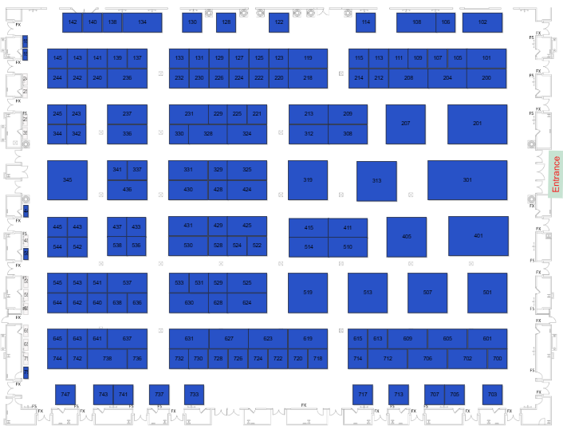
2025 Partner Booth Locations
321
2025 Partner Booths
Link to Hall Map
Toshiba Booth #501
Partner Booths
230
204
243
304
Company Name | Booth #
Auto-Star Compusystems, Inc. | 304
BlueStar | 301
DataLogic | 230
Havis | 243
IMin Technology | 712
Ingenico | 522
LOC Software | 436
MagTek | 514
ScanSource | 405
SpacePole | 337
Verifone | 204
301
337
436
620
405
522
514
501
712
Notes:
Floorplan for 2025 https://homebase.map-dynamics.com/retailnow2025/floorplan

